Slide 1
Project Presentation of Industry Oriented Hands on Experience(22CS422)
On
Quizy – AI-Powered Quiz Generator
Saurabh Malik(2210992269)
Shivam (2210992317) Shivam (2210992307) Rohit(2210992177)
Supervised By
Dr Preeti Saini
Department of Computer Science and Engineering,
Chitkara University, Punjab

Slide 2
Table of Contents
• Abstract
• Problem Statement
• Key Features
• Technical details
• Literature Review
• Workflow Diagram
• Implementation
• Results/Outputs
• Conclusion
• Future Scope
2

Slide 3
Abstract
Quizy is an AI-powered quiz generator that instantly creates dynamic quizzes from any topic, empowering students to test and improve their knowledge on the go.
It offers a personalized learning experience through adaptive questions, real-time feedback, and visual insights like word clouds to track focus areas.
Designed to make self-assessment smarter and more engaging, Quizy transforms traditional test-taking into an interactive and efficient learning journey.
3

Slide 4
Problem Statement
Most quiz platforms are static and repetitive, failing to adapt to individual learning needs or pace.
They lack personalization, real-time feedback, and engaging elements, making self-assessment dull and ineffective.
Students need a smart, interactive solution that generates dynamic quizzes and provides meaningful insights to boost independent learning.
4

Slide 5


Key Features & Functionalities
AI-Powered Quiz Generation Generates quizzes instantly from any topic using NLP-based AI models.
Multiple Question Formats Supports MCQs, fill-in-the-blanks, and short-answer questions for varied assessments.
Adaptive Learning Experience Adjusts question difficulty based on user performance to promote effective learning.
Real-Time Feedback & Analytics Displays results instantly with visual insights like word clouds for topic focus.
Secure Google-Based Login Ensures role-based access and data privacy using Firebase Authentication.
Quiz Export & Offline Access Allows users to download quizzes and results in PDF format for offline review.

Slide 6
Technical Architectural
Frontend 🔹 Next.js – React framework for fast rendering 🔹 Tailwind CSS – Responsive UI styling 🔹 WordCloud.js – For word cloud visualizations
Backend 🔹 Node.js + Express.js – Handles API routes, logic, and server operations 🔹 Prisma ORM – Manages database communication with typed queries
Database 🔹 NeonDB (PostgreSQL) – Cloud-native database for storing quizzes, users, results
Authentication & Hosting 🔹 Firebase Auth – Secure Google login 🔹 Firebase Hosting / AWS – Project deployment
AI Integration 🔹 Gemini API – Generates quiz questions using NLP

Slide 7
Literature Review
Gemini API Docs: Implements NLP-based quiz generation from text, serving as the project’s core AI engine for creating dynamic quiz questions.
Prisma ORM Docs: Utilized for writing typed database queries with PostgreSQL, ensuring secure and efficient database interactions.
Firebase Auth Docs: Provides Google-based user authentication, enabling a reliable and secure login system for users.
WordCloud.js: A JavaScript library used to create word clouds, helping visualize keyword focus and topic prominence in results.
Next.js Documentation: Supports hybrid static and dynamic rendering with React, ensuring fast, optimized, and scalable frontend performance.
7

Slide 8
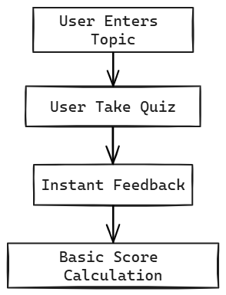
Workflow Diagram
Data Flow Diagram Level 0:
8

Slide 9
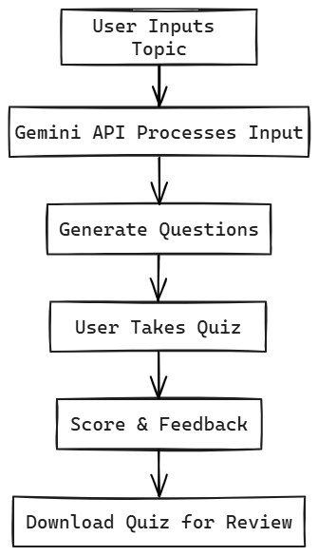
Workflow Diagram
Data Flow Diagram Level 1:
9

Slide 10
Implementation
Quiz Generation: The system utilizes the Gemini API for NLP-based question generation, automatically creating quizzes from input text or documents.
Database Management: All quiz data, user responses, and performance analytics are stored securely using Prisma ORM with PostgreSQL, ensuring structured and efficient database interaction.
User Authentication: Firebase Authentication provides a secure and reliable Google-based login system for users to access personalized quiz dashboards.
Frontend Interface: Developed using Next.js and React, the frontend offers a fast, responsive, and intuitive interface for taking quizzes and viewing results.
Visualization: WordCloud.js is used to visualize keyword frequency and highlight the most important topics from quiz data and learning materials.
Tech Stack: Next.js (Frontend), Node.js & Express.js (Backend), Prisma ORM with PostgreSQL (Database), Firebase (Authentication), WordCloud.js (Visualization).

Slide 11
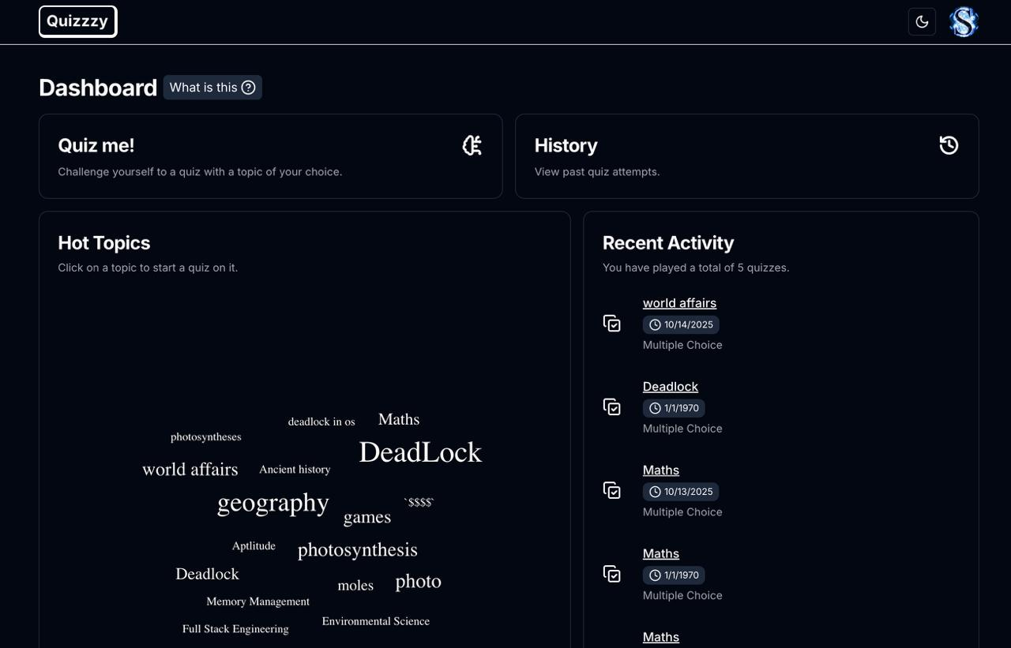
Results / Output

Slide 12
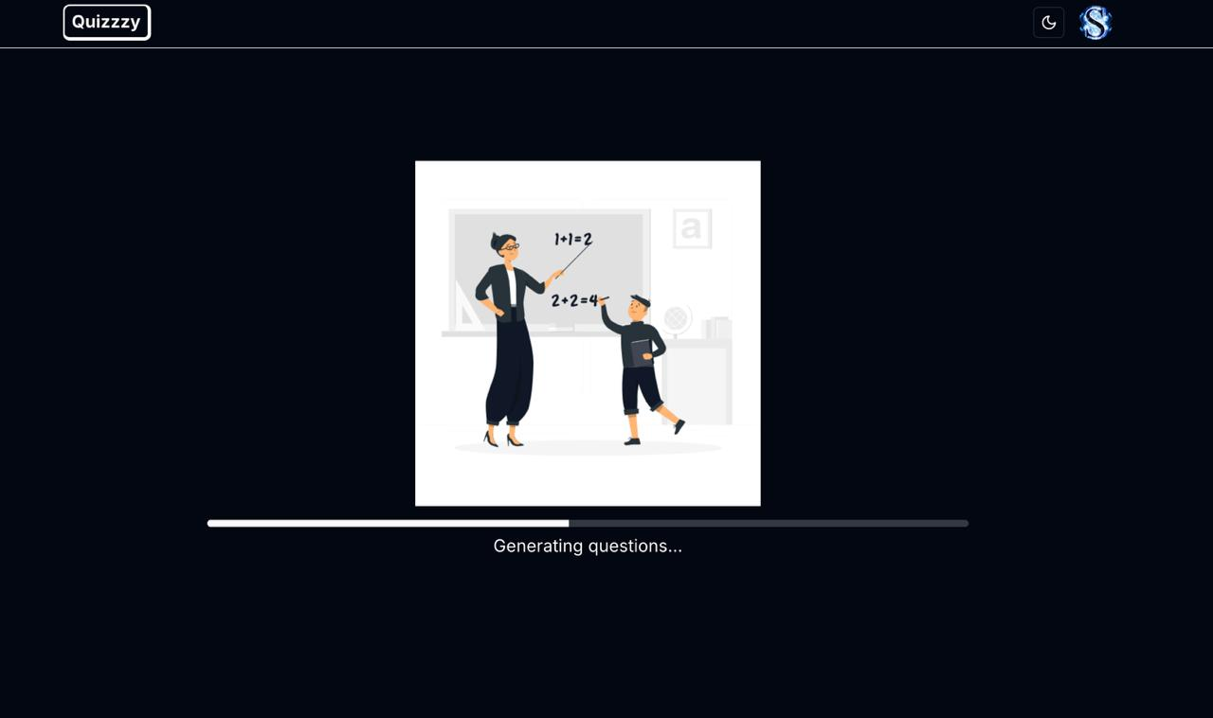
Results / Output

Slide 13
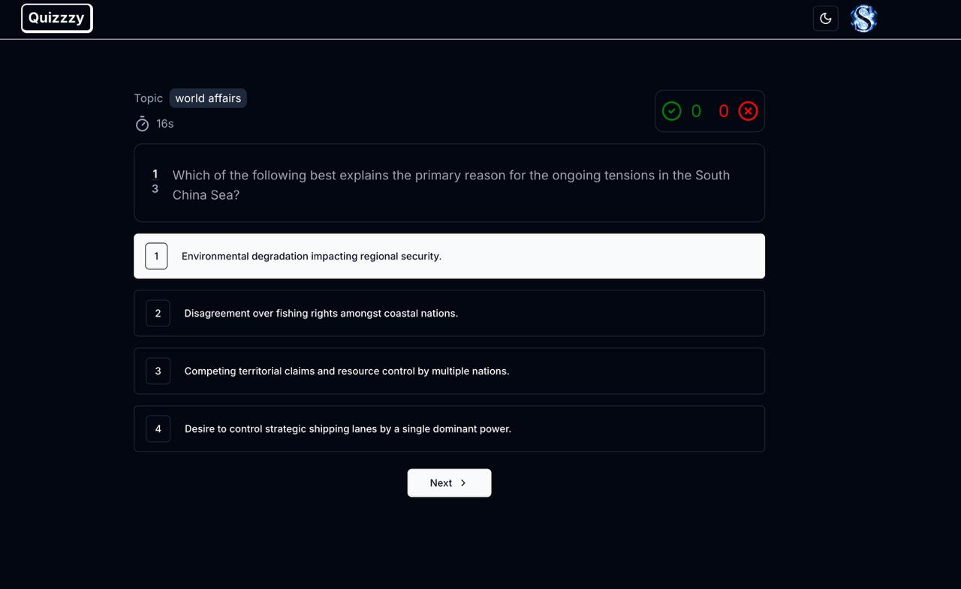
Results / Output

Slide 14
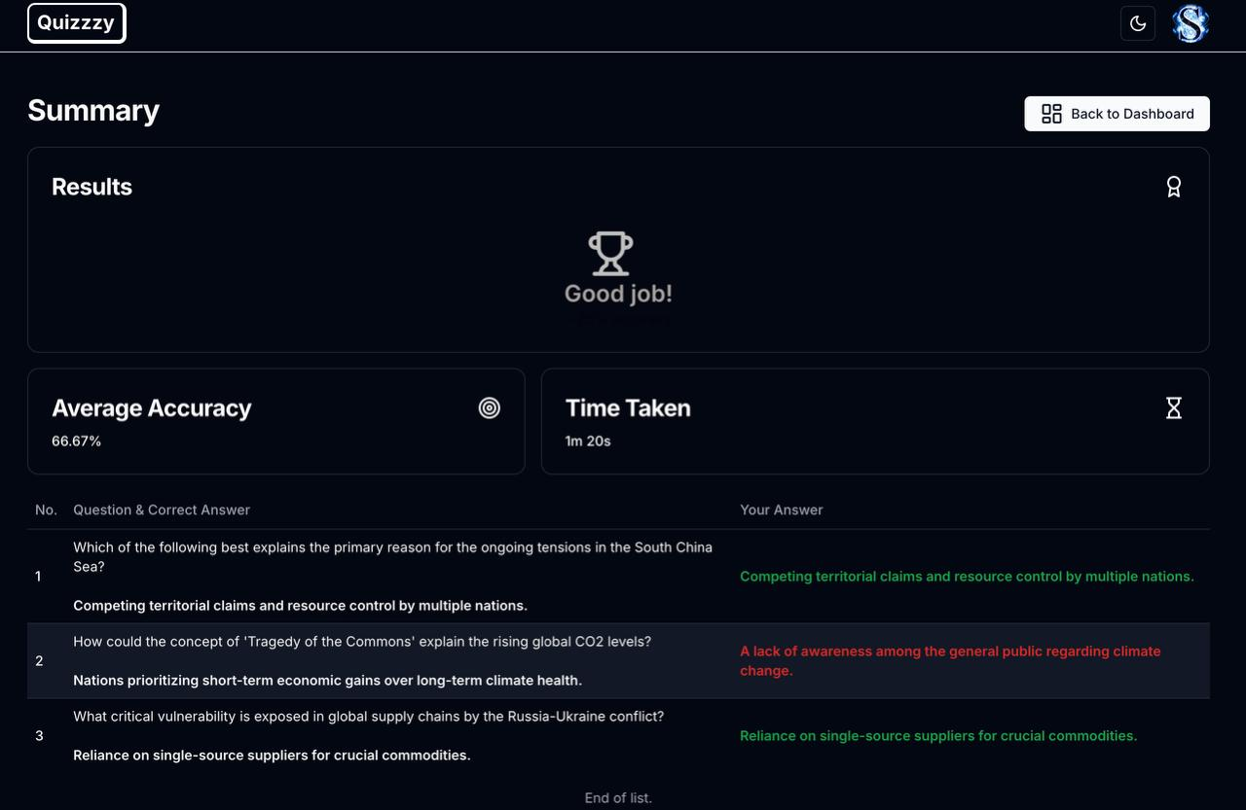
Results / Output

Slide 15
Conclusion and Future Scope
Conclusion
Quizy successfully demonstrates how AI can automate and personalize quiz creation.
The system integrates Gemini API, Firebase Auth, and NeonDB to ensure scalability and security.
Real-time quiz generation and instant feedback enhance user engagement and learning outcomes.
Adaptive question difficulty makes the experience more tailored and effective.
Quizy bridges major gaps found in static or rule-based quiz platforms.
Future Scope
Integrate voice-based and multimodal input for accessibility and ease of use.
Expand multilingual support for regional and global learners.
Develop a mobile app version for wider reach and offline access.
Add AI-driven analytics dashboards for performance insights and learning recommendations.
Enable collaborative quiz creation and gamified leaderboards for group learning.

Slide 16
References
React Documentation. Building User Interfaces with React. Available at: https://react.dev
Node.js Foundation. Server-side JavaScript Runtime Environment. Available at: https://nodejs.org
MongoDB, Inc. NoSQL Database for Modern Applications. Available at: https://www.mongodb.com
Express.js. Web Application Framework for Node.js. Available at: https://expressjs.com
Tailwind CSS. Utility-First CSS Framework for Rapid UI Development. Available at: https://tailwindcss.com
Research Article: Full-Stack Web Applications Using MERN Stack for Data Management and Visualization, IEEE Xplore, 2023.

Slide 17
Thank You
17

